Slide 1
P
raedico
A custom recommender engine for The Book Empire

Slide 2

E
very once in a while, a
new technology, an
old problem, and a
big idea turn into an
innovation.

Slide 3


Introduction
Logo Design
DYNAMIC
RECOMMENDATIONS
STATIC
RECOMMENDATIONS

Slide 4
9.4 M
8.5M

Slide 5
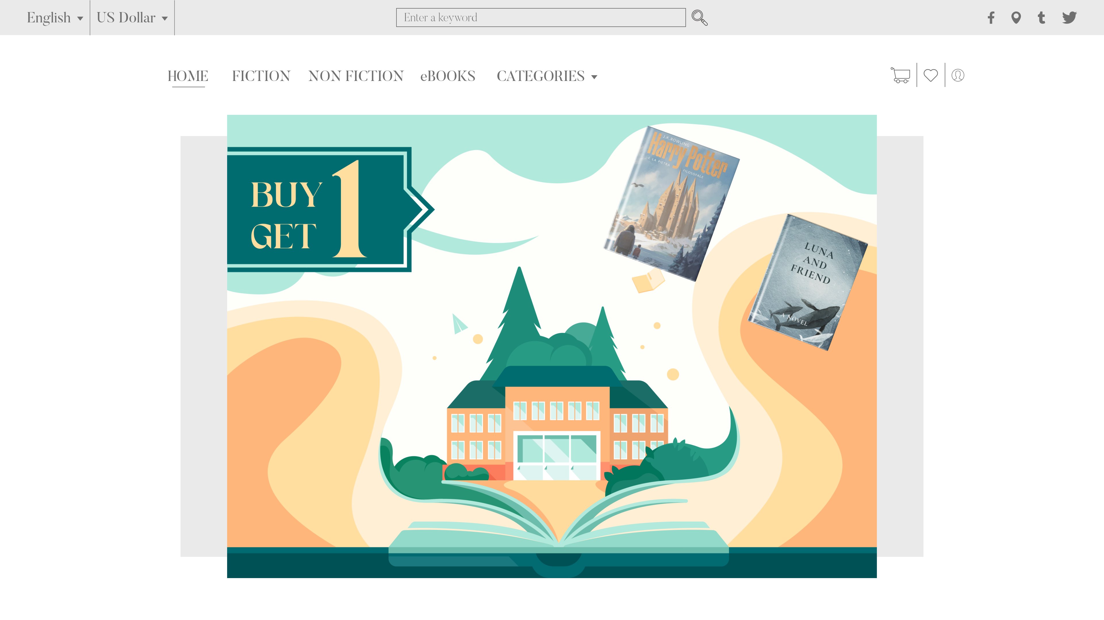
STATIC
RECOMMENDER

Slide 6
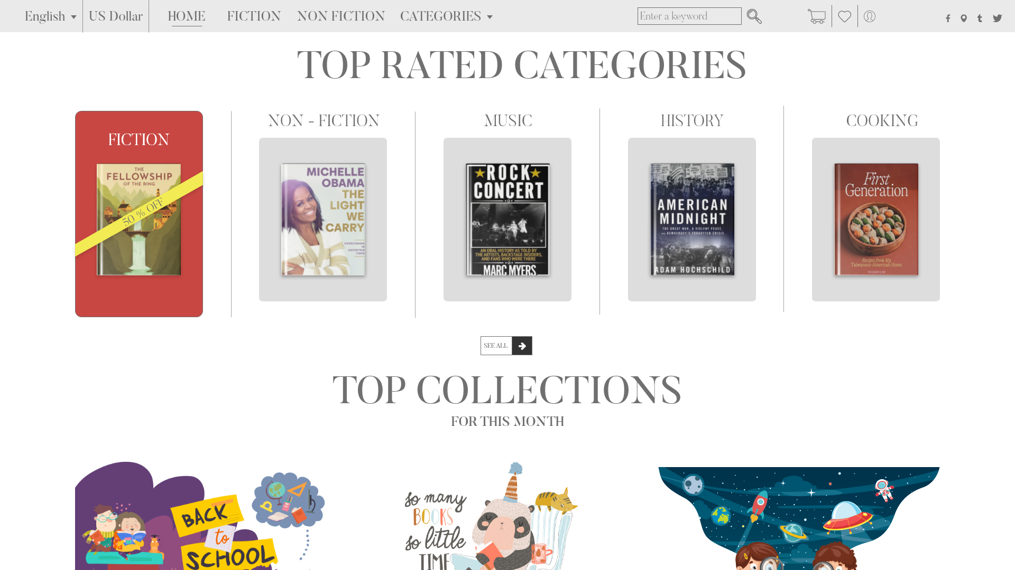
STATIC
RECOMMENDER
DYNAMIC
RECOMMENDER

Slide 7
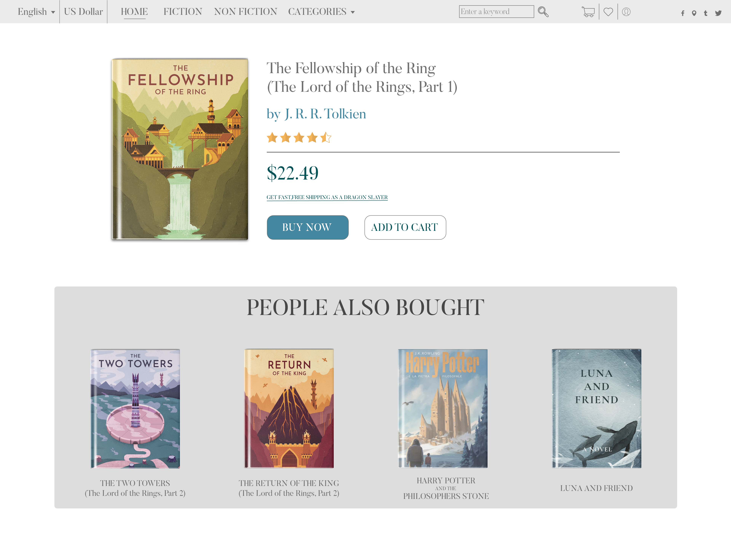
DYNAMIC
RECOMMENDER

Slide 8
15%
SEGMENTS
50%
85%
100%

Slide 9
GATHER DATA
&
PROCESSING
MARKETING
& FINANCE
INPUT
1
2
3
4
5
6
7
BUILDING THE RECCOMENDER ENGINE
IMPLEMENT
IN WEBSITE
* IN WEEKS

Slide 10

Thank -
you.

